Slide 1


Tutorial: Squat Scanner
Foundations of Cybersecurity
Giacomo Benedetti
Institute for Applied Mathematics and Information Technologies
National Research Council of Italy
giacomo.benedetti@ge.imati.cnr.it
University of Pavia – Department of Electrical, Computer and Biomedical Engineering

Slide 2
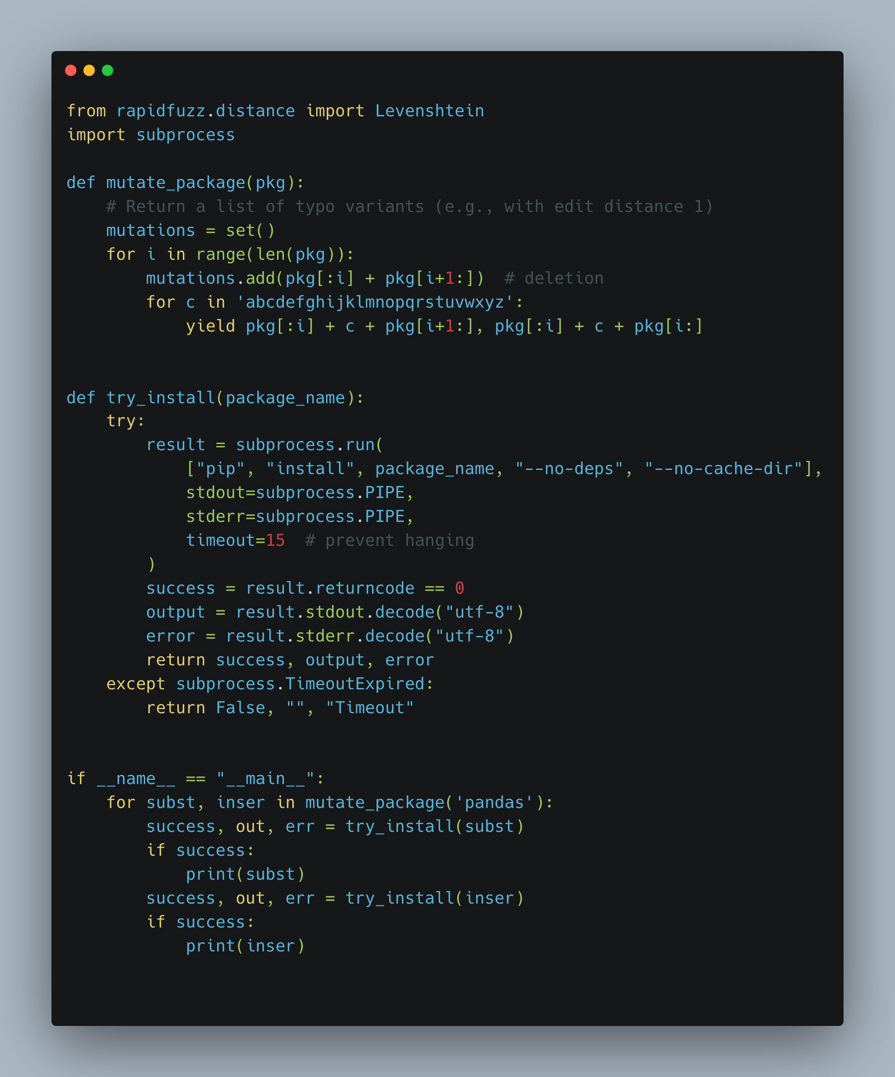
Package Names Similarity: Is it Common?
This example contains a small fuzzer for testing the presence of typosquatted packages.
Idea:
  generating package names
  try to retrieve them to check whether they exist
  if yes, inspect collected output.

Slide 3
Package Names Similarity: Is it Common?
substitution
insertion

Slide 4
Package Names Similarity: Is it Common?
pandas
substitution
insertion
pabdas
panbdas

Slide 5
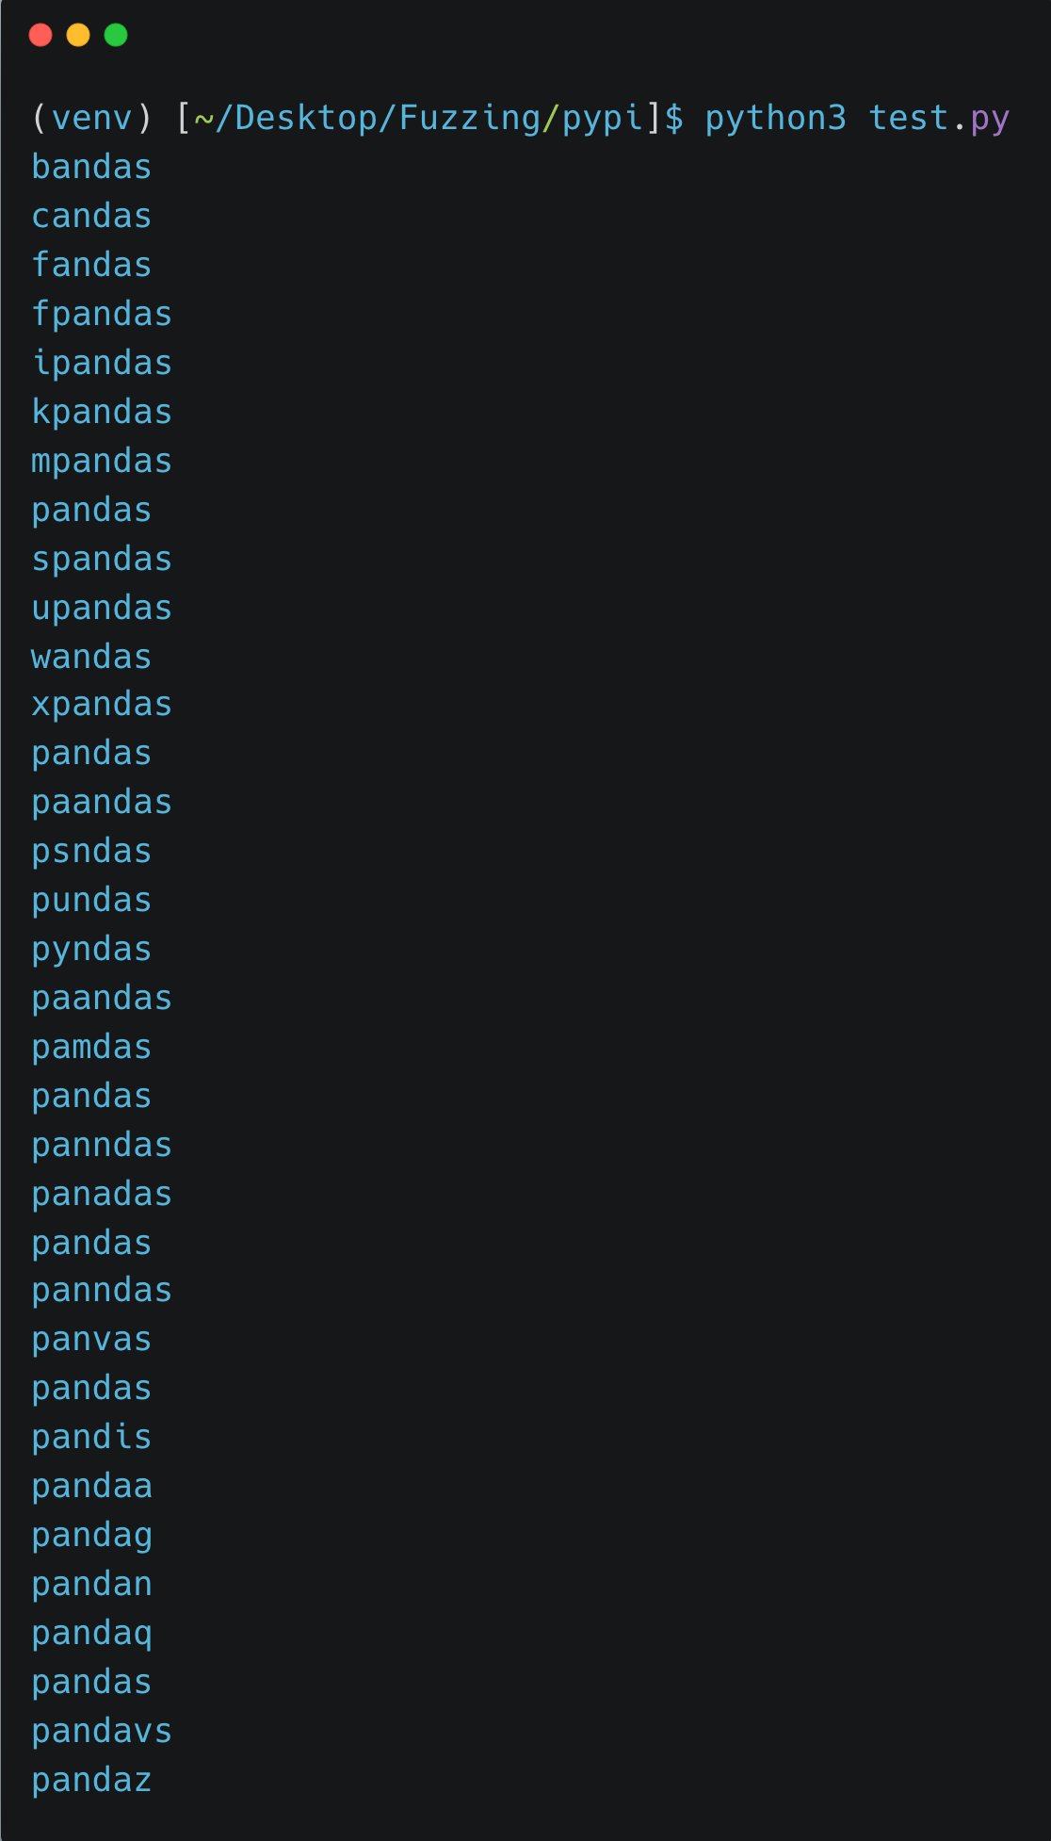
Package Names Similarity: Is it Common?
pandas

